Slide 1
ELEVATE LABS DATA ANALYST INTERNSHIP TASK 8
POWER BI
Nazim Atakan Erdogan

Slide 2

Alternative 1
General

Slide 3
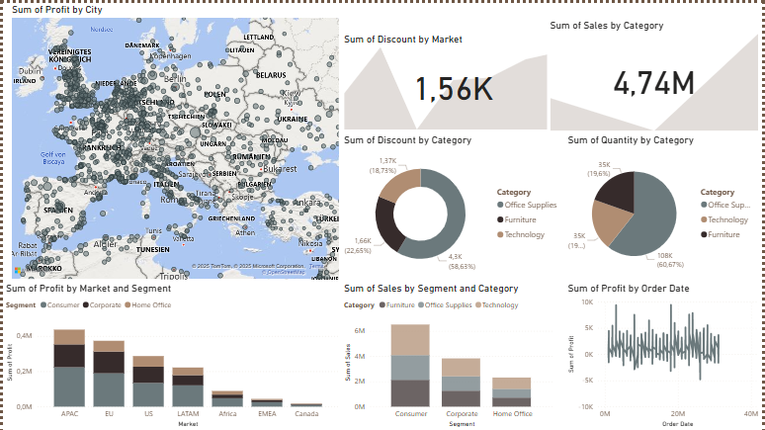

Slide 4
Alternative 2
Technology

Slide 5
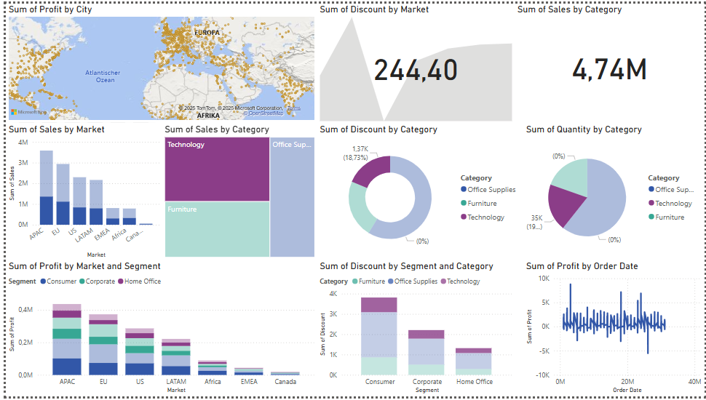

Slide 6
Alternative 3
Furniture

Slide 7
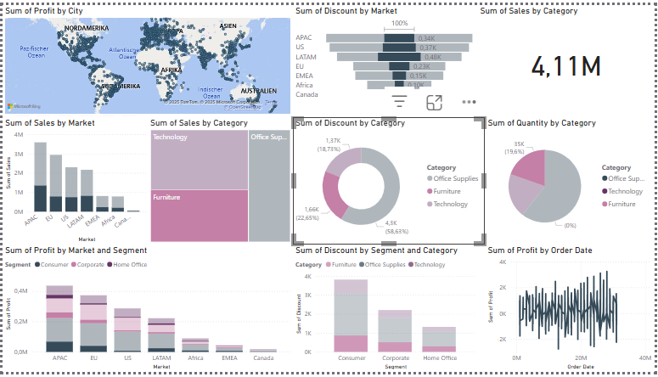

Slide 8
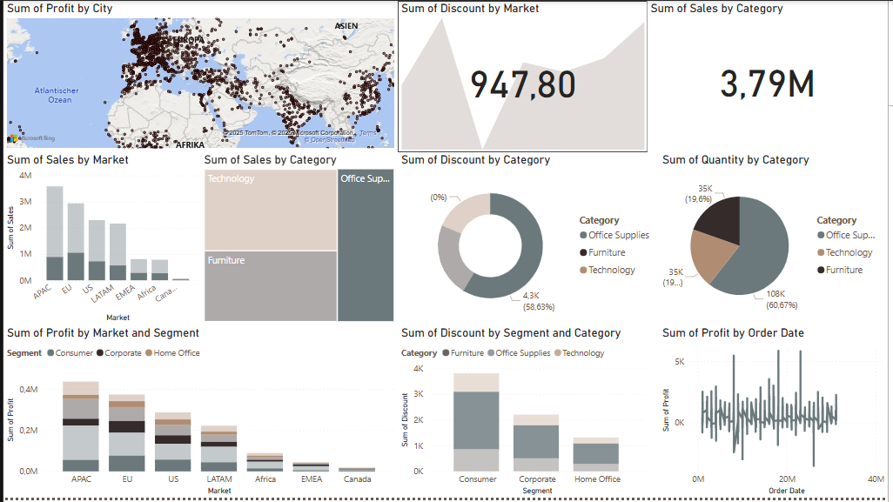

Slide 9
Insights
Office supplies have the highest percentage of total discount among other categories.
The category technology has the lowest percentage of discounts and lies in the middle in terms of sum of quantities.
Office supplies have the highest range of quantity and highest sum of sales at APAC region.
Furniture category has the highest discount in LATAM Market

Slide 10
THANK YOU

